Slide 1

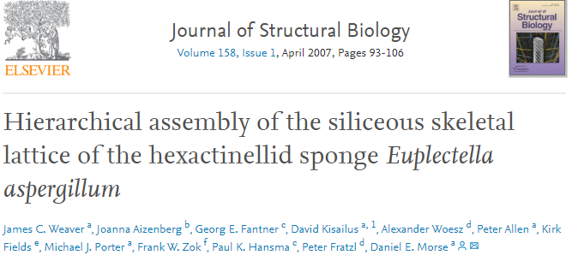
01
Structure
of
Euplectella aspergillum
Macro- & Micro-structure

Slide 2
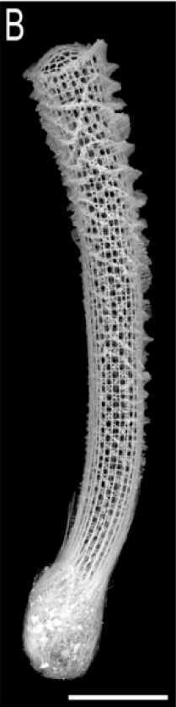
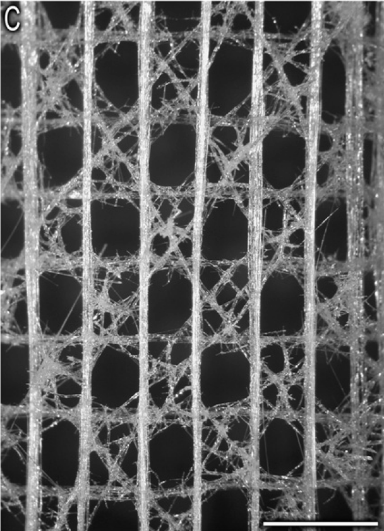
01
Structure of Euplectella aspergillum
Macro- & Micro-structure
Notes:
It’s mainly consisted of Straight line & transverse line
Network of diamond shape on both sides

Slide 3
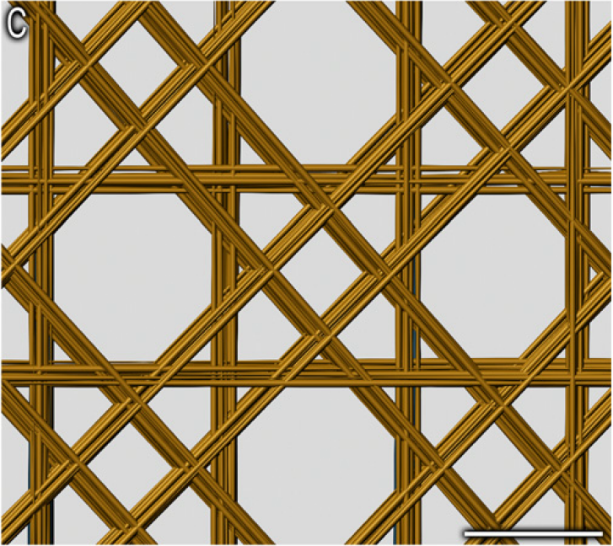
01
Structure of Euplectella aspergillum
Macro- & Micro-structure
Notes:
Illusion for the 2D skeleton
If we simplify the network structure all to straight lines

Slide 4
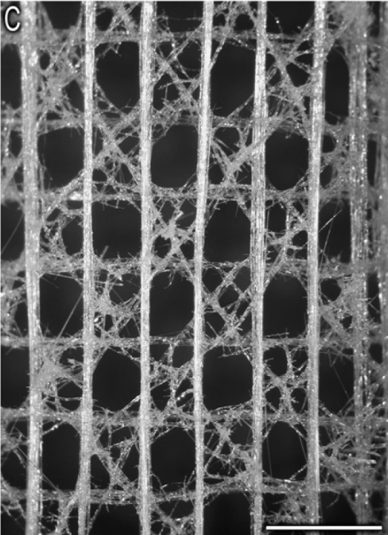
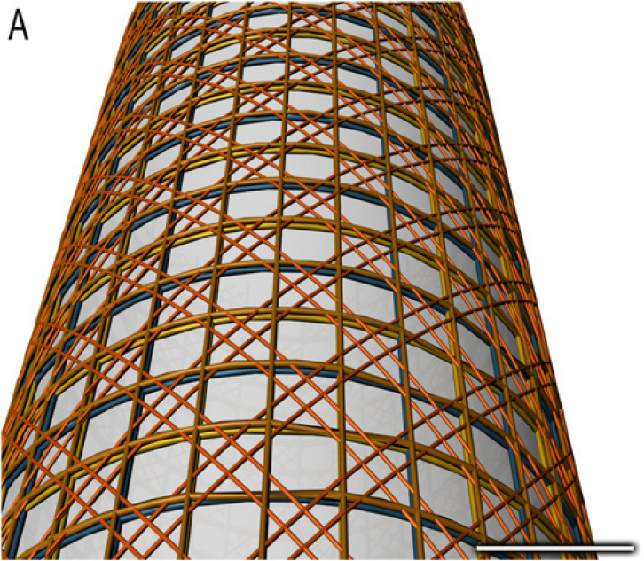

01
Structure of Euplectella aspergillum
Macro- & Micro-structure
Notes:
Bend as a column

Slide 5
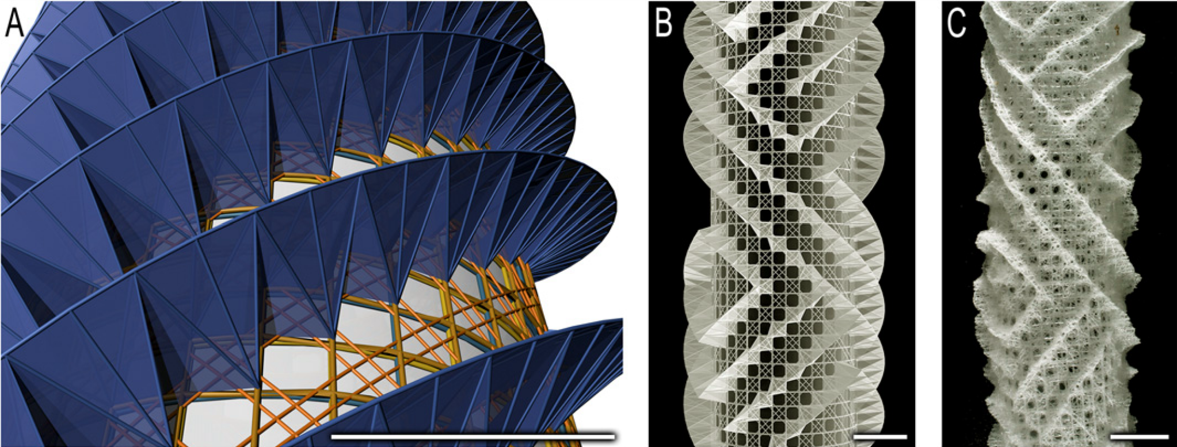
01
Structure of Euplectella aspergillum
Macro- & Micro-structure
Notes:
Helical structure around the skeletal lattice

Slide 6
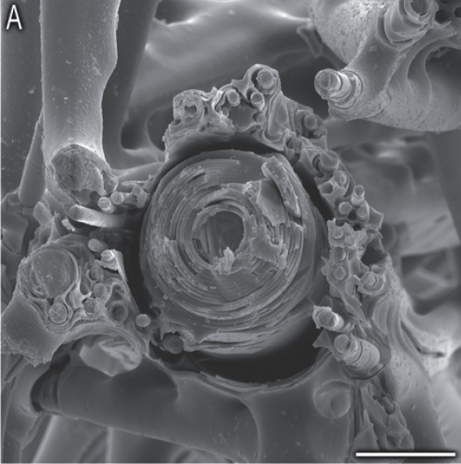
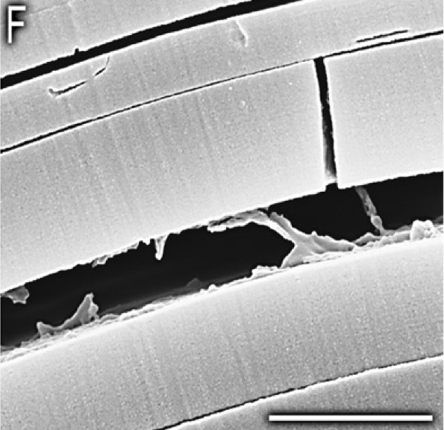
01
Structure of Euplectella aspergillum
Macro- & Micro-structure
Notes:
Spicules with layer structure in it

Slide 7
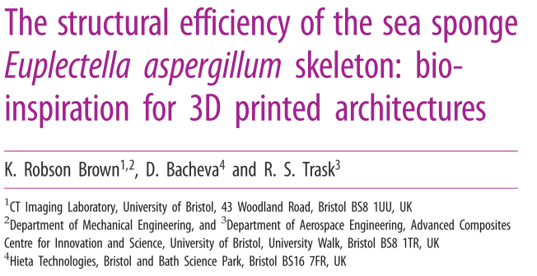
02
3D - printed
Compressive
test
Compressive test & finite element simulation

Slide 8
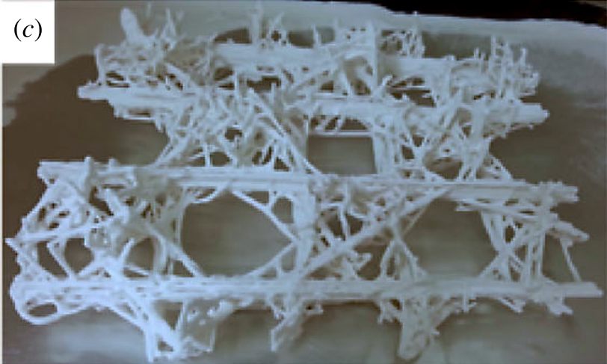
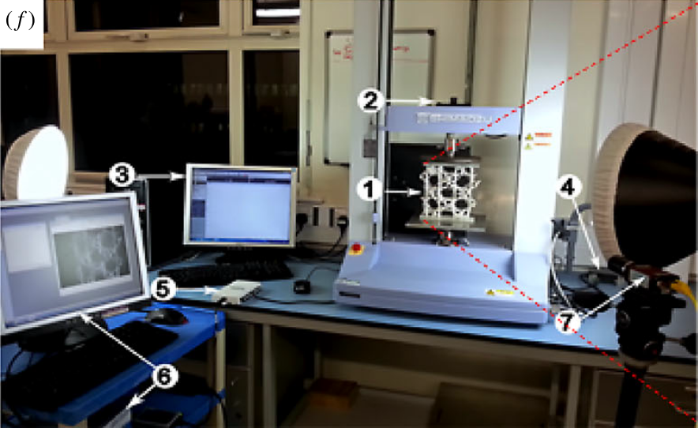
02
3D – printed Compressive test
Compressive test & finite element simulation
Notes:
3DP

Slide 9
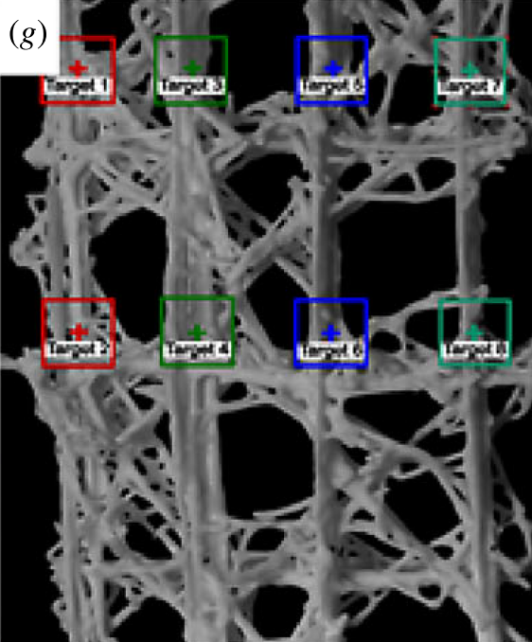
02
3D – printed Compressive test
Compressive test & finite element simulation
1
3
5
7
2
4
6
8
Notes:
They use a video extensometer to record relative displacement during loading, and set 4 pairs of target for it

Slide 10
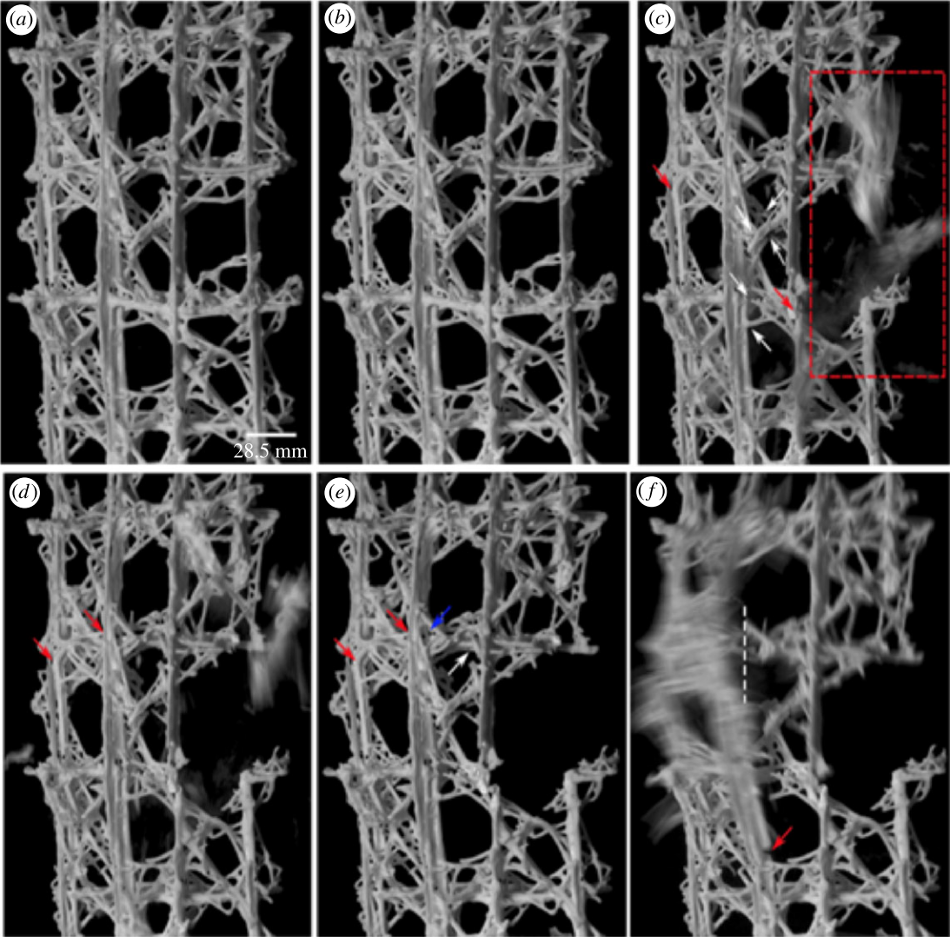
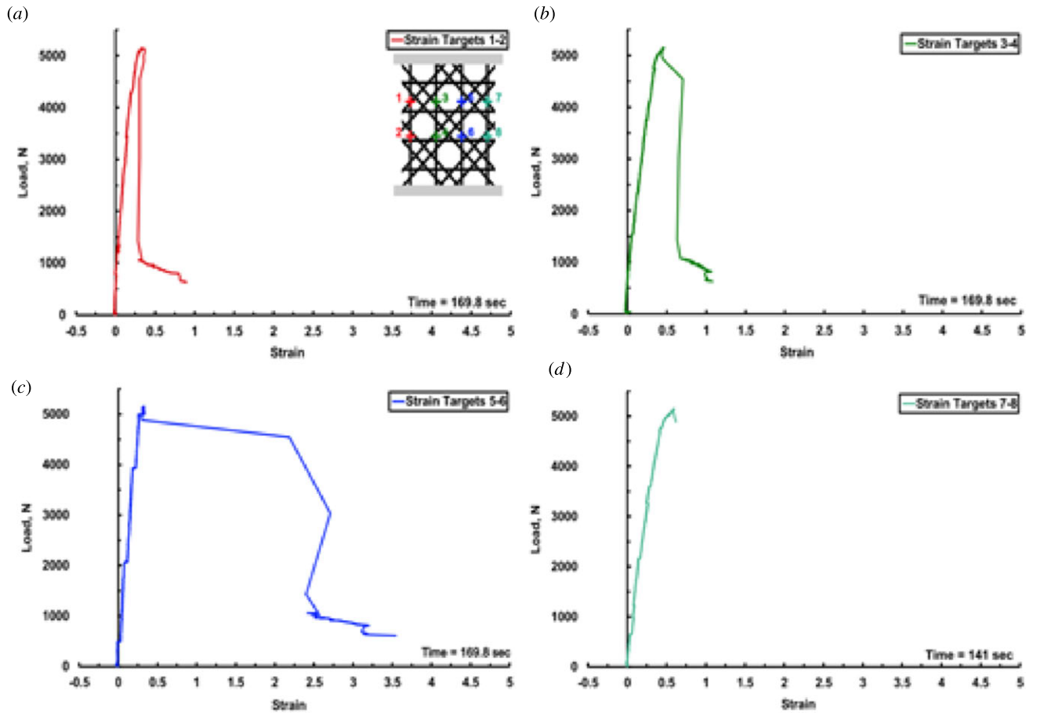
02
3D – printed Compressive test
Compressive test & finite element simulation
7
8
Notes:
In the initial stage of failure
The sudden break of fragments from the vertical beam on the right can be clearly seen with the sudden loss of strain on targets 7-8

Slide 11
02
3D – printed Compressive test
Compressive test & finite element simulation
1
2
Notes:
Simultaneously, brittle fracture in the left vertical beam also occurred, and it’s recorded as a load drop for strain target 1–2

Slide 12
02
3D – printed Compressive test
Compressive test & finite element simulation
5
6
Notes:
The redistribution of the load across the remaining vertical beams take place
After the brittle fracture, a slight rotation of the sample in the outward direction due to the redistribution of the load once again, resulting in further increase in strain.

Slide 13
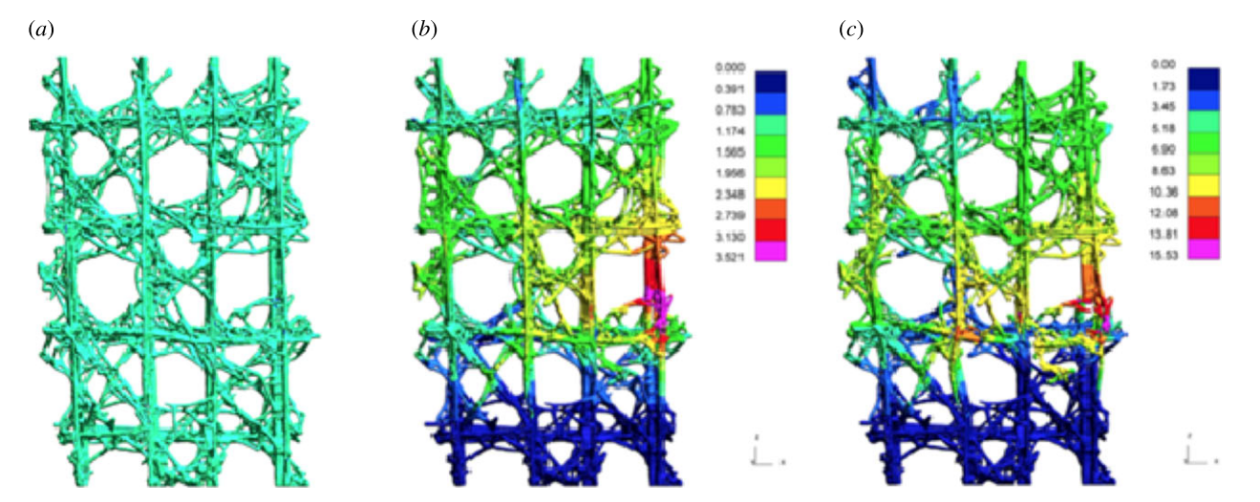
02
3D – printed Compressive test
Compressive test & finite element simulation
Notes:
The finite simulation result also shows that the right beam encounters the highest stress
KCC model

